Slide 1


FPT Aptech
Artistry Social Network
Group 2

Slide 2


ABOUT US
Supervisor
Truong Thanh Trung
Team Members
Le Viet Dong
Huy Tan Phuoc
Tran Thu Huy
Tran Tien Nam

Slide 3








TECHNOLOGY
Nextjs 14
Web Socket
Spring boot
Elasticsearch
Microservices
MongoDb
Docker
MySql

Slide 4



Project Highlights
FLEXIBILITY AND SCALABILITY
REAL-TIME DATA PROCESSING
PIONEERING IN THE FIELD
The microservices architecture helps the project scale easily by dividing functionalities and services into small, independent modules. This allows scaling to only expand the necessary parts of the system without affecting others."
Processing real-time data and providing quick search results and responses to users.
The first application in the market focusing on providing a connectivity and booking environment within this field.

Slide 5
2
Limitations and Proposed Solutions
Limitations
Proposed Solution
Complexity in Integration
Continuous Feature Enhancement
Data Security Concerns
Access Control and Authentication
User Adoption Challenges
User Feedback Integration

Slide 6
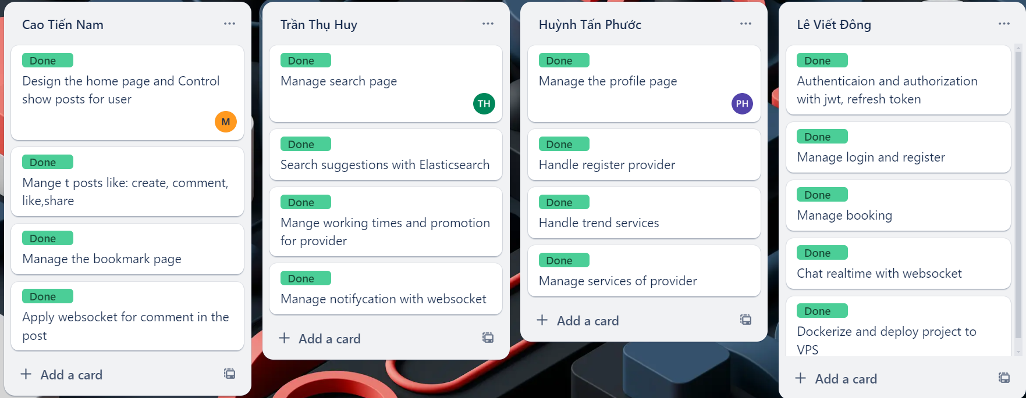
TASK SHEET

Slide 7













Thank you very much!

